Slide 1
HYFIX Website
October 2020

Slide 2
Outline - Pages
About/Who Are We?
Global Network
Applications
Core Technologies
PAS/Blockchain
Get In Touch/Connect With Us

Slide 3
About
HYFIX is embarking on a mission to democratize the sensor data by making it globally available, accessible, and affordable. As a first step towards this journey, we are building a global network of RTK reference stations to provide a hardware agnostic, fully modernized, multi-constellation, open-standard based, high precision data and correction services to users in IoT and other markets. Founded by the pioneers in IoT, Sensor Fusion, Inertial Navigation and GNSS networking, we are headquartered in the heart of the Silicon Valley.

Slide 4





Global Network
HYFIX aspires to build the largest global RTK network with fully modernized receivers to provide hardware-agnostic and open-standards based correction services. We plan to realize this goal is by establishing close partnerships with hardware providers to deploy new base stations, supplementing with existing open networks , forming alliances with regional public network services and collaborating with local independent. By deploying a global network of base stations, HYFIX will provide cost-effective, high precision data and correction services to users globally.
Global
Agnostic
Interoperable
Open
Affordable

Slide 5




Applications
The trend in many industries to embrace IoT, Autonomy and Augmented Reality Visualization is creating a large high-accuracy positioning market for lower-cost devices and services. Significant challenges remain in obtaining high-accuracy position data using low-cost GNSS receivers due to their tendency to obtain poor quality measurements especially under challenging environments. HYFIX’s software and services help solve these challenges and unlock new applications that benefit from high accuracy positioning.
IoT
AR/VR
eMobility
Autonomy

Slide 6




Core Technologies
RTK GNSS: HYFIX positioning services provide cm level precision to enable mass market applications
Dead Reckoning: Sensor fusion of IMU, GNSS and other sensor data, HYFIX algorithms can provide precise positioning during GPS outages
LoRaWAN: LoRaWAN wireless gateway allows any compatible LoRa IoT device to transfer data on PAS network
Blockchain: Blockchain powers the network and serves as the underlying technology for PAS cryptocurrency

Slide 7




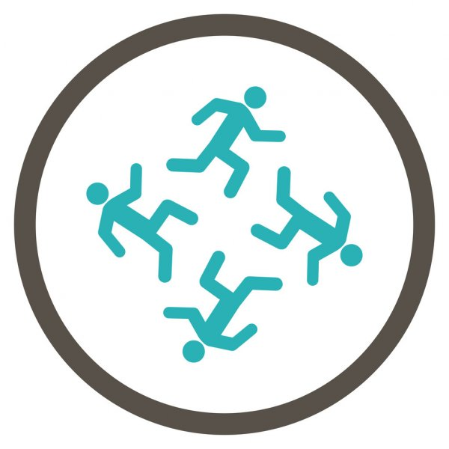
PAS
Precision As a Service (PAS) is a blockchain based token that enables peer-to-peer networking for data aggregation and distribution. PAS blockchain allows GNSS base stations to mine PAS cryptocurrency. By connecting your base stations into this blockchain network, you can be part of the global network and get rewarded with PAS tokens. The users of the network will use these tokens to access the services.
Resiliency
Security
Redundancy
Scalability
Concurrency

Slide 8
Get In Touch
Lead Capture Form
Name
E-mail address
Phone Number
Your Location
Message/Comments

